Slide 1
The African Americans: at a glance
http://blackdemographics.com/Demographic trends
Photos, Tony Fischer, NYC, 2009 (Flickr)

Slide 2
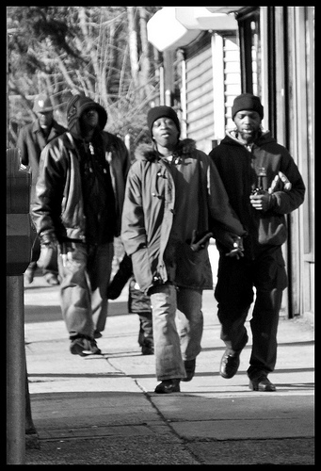
Education
83.2%: The percentage of blacks
25 and older with a high school
diploma or higher in 2012
18.7%: The percentage of blacks
25 and older who had a bachelor’s
degree or higher in 2012
1.6 million: Among blacks 25 and
older, the number who had an
advanced degree in 2012.
3.7 million: Number of blacks
enrolled in college in 2012 compared
with 2.9 million in 2007,
a 28 percent increase.
(U.S. Census Bureau News,
februar 2014)

Slide 3
EDUCATION
42 percent of black children are educated in all high-poverty schools (White children 6 percent)
Unemployment rate for black high school dropouts is 47 percent. (White dropouts 26 percent)
(M. Morris: Black Stats: African Americans by Numbers, 2014)

Slide 4
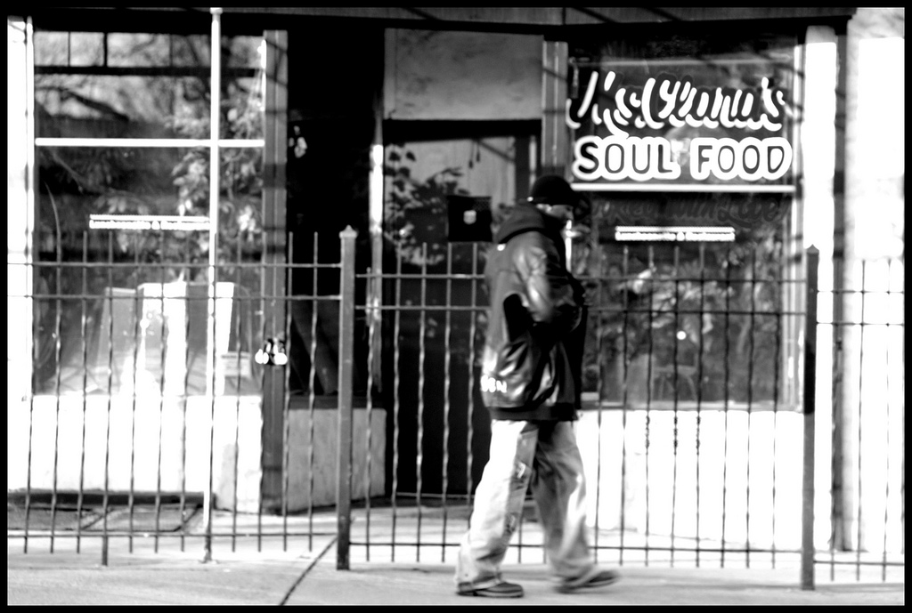
INCOME
$33,321: The annual median income of black households in 2012, compared with the nation at $51,017.
(Source: U.S. Census Bureau, Income, Poverty and Health Insurance Coverage in the United States)

Slide 5
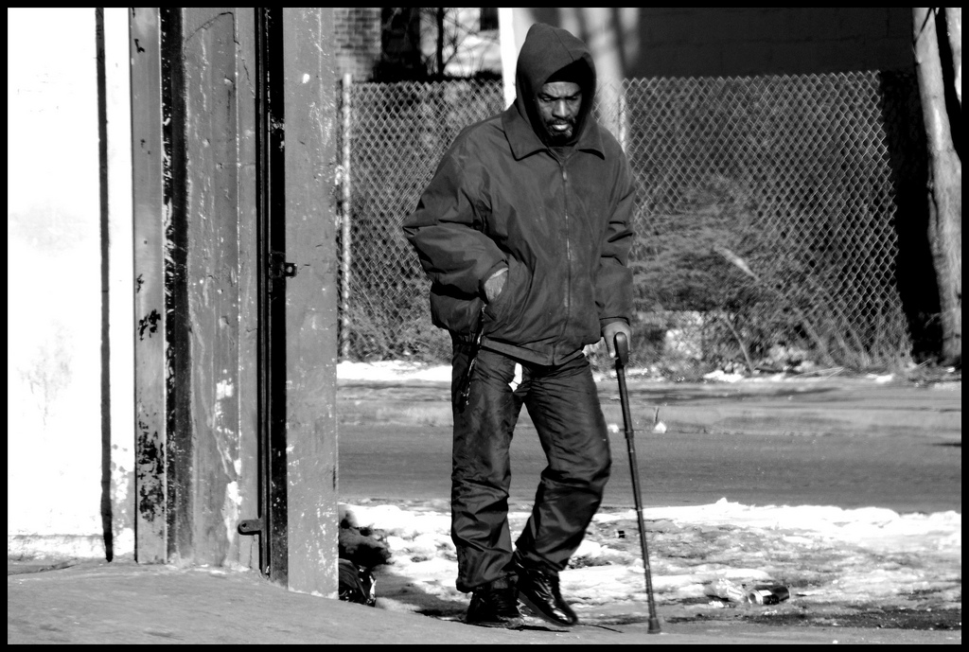
Poverty

Slide 6
Health
Black mothers are more than twice as likely as White mothers to experience the death of a baby within the first 28 days of the infant’s life
African Americans make up 4 percent of all adults reporting serious psychological distress, but that percentage doubles for African Americans below the poverty line
(M. Morris: Black Stats: African Americans by Numbers, 2014)

Slide 7
Crime
Only 14 percent of Black Americans have a great confidence in local officers to treat Black and White Americans equally, compared with 38 percent of Whites
Nationwide, 16 percent of persons under age of 18 are Black, and 32 percent of total juvenile arrests are of Black youth
The rate of drug use among Black people ages 2 and older is 10 percent, yet Black people account for 32 percent of those arrested for ”drug abuse violations”.
(M. Morris: Black Stats: African Americans by Numbers, 2014)

Slide 8
CRIME
55 percent of Black Americans report avoiding certain places or neighborhoods because of concern over crime, compared with 46 percent of White Americans

Slide 9
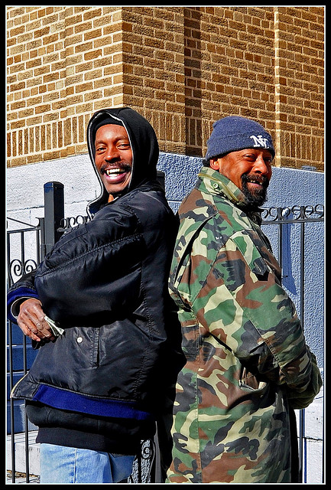
MONEY & JOBS
The unemployment rate
for African Americans with a
four-year college degree is
8 percent. For Whites 4.5
percent.
Although Black people(inclu-
ding multuracial Black) make
up just 14 percent of the popu-
lation, 37 percent of people
who are homeless are Black.

Slide 10
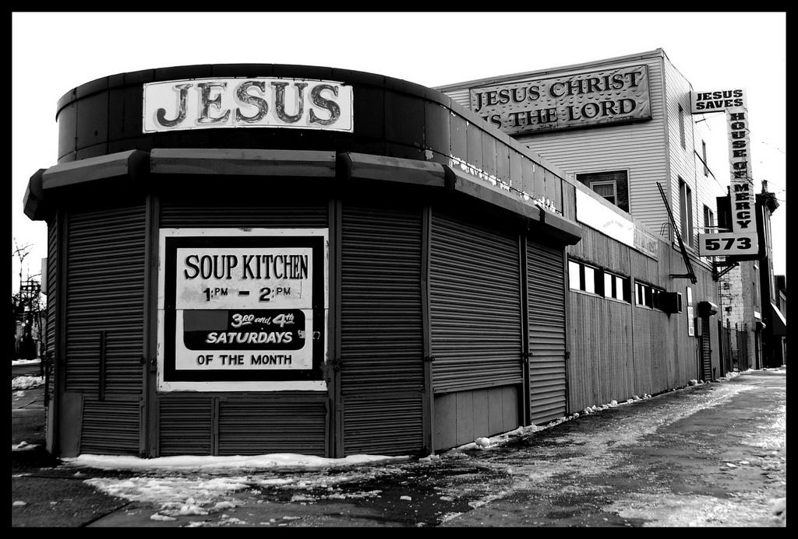
THE ECONOMIC CRISIS
African Americans
are twice as likely as
all Americans to
have been affected
by the mortgage
lending crisis and
ultimately to have
lost their homes.
(M. Morris: Black Stats:
African Americans
by Numbers, 2014)

Slide 11
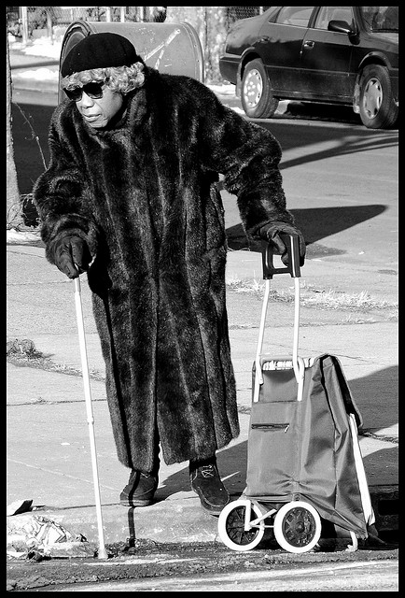
VOTING
25 percent of elderly
African American voters
(compared with 8
percent of elderly Whites)
do not possess the identi-
cation that would be
required under new pho-
to-ID laws introduced in
40 states before the
2012 election.
(M. Morris: Black Stats: African Americans by Numbers, 2014)

Slide 12
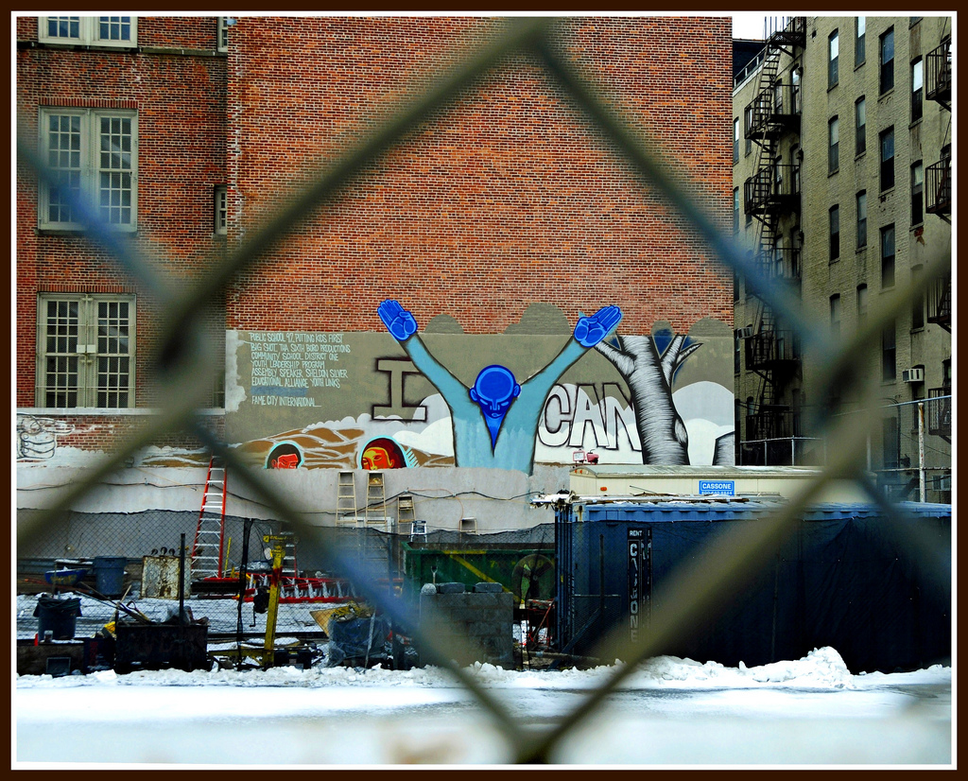
VOTING
One in every 13 African
Americans of voting age
is disenfranchised be-
cause ofa felony convic-
tion, a rate more than
four times greater than
the rate for the rest of
the U.S. Population.
(M. Morris: Black Stats:
African Americans by Numbers, 2014)

