Slide 1
THE OAKLAND RIOTS, 2010
PHOTO REPORTING
by
THOMAS HAWK
https://www.flickr.com/photos/thomashawk/sets/72157624455565162

Slide 2
Last night protesters in Oakland, CA rioted after a Los Angeles jury convicted former BART Police Officer Johannes Mehserle of Involuntary Manslaughter. Mehserle, a whilte police officer, had been on trial for a highly visible shooting of black Oscar Grant in the back during a 2009 New Year's Day incident at the Fruitvale BART station.
Protesters had been planning for over a week to meet at the corner of Broadway and 14th streets in Downtown Oakland after the verdict was announced to respond. Local community leaders and activists had been advocating a peaceful gathering after the verdict, but last night's gathering in the end turned violent as many suspected it would.

Slide 3
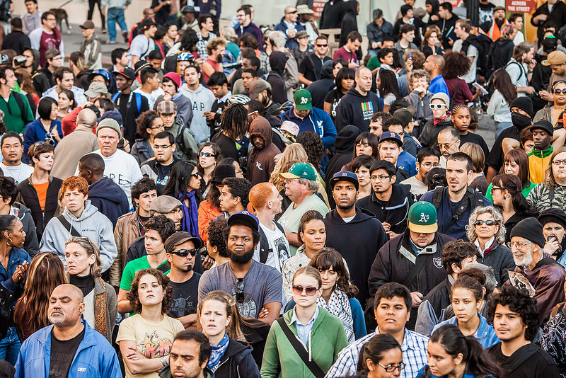

Slide 6
When I first arrived at the corner at 4pm the tension was pretty high. There was a small group of people (maybe 50) mostly composed of news media, photographers and a handful of protesters. Protesters were hoping that Mehserle would be convicted of 2nd degree murder. When he came in as not guilty of 2nd degree murder and instead only guilty of involuntary manslaughter, people immediately started reacting. Mostly it was just individual protesters giving loud speeches for the TV cameras. Many of the speeches were very inflammatory with one protester saying that white people needed to be murdered. At this point there were no police in sight.

Slide 7
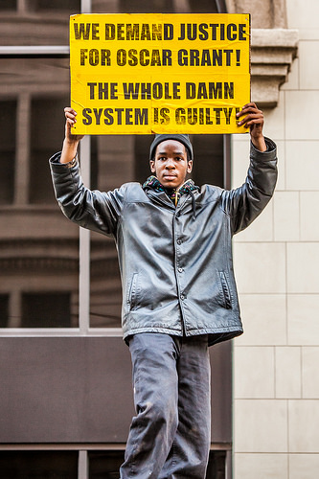
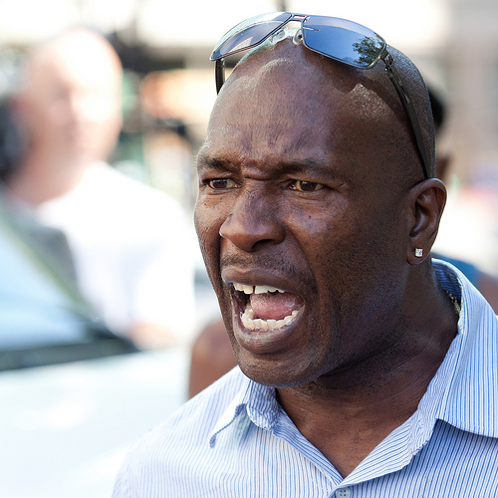

Slide 8
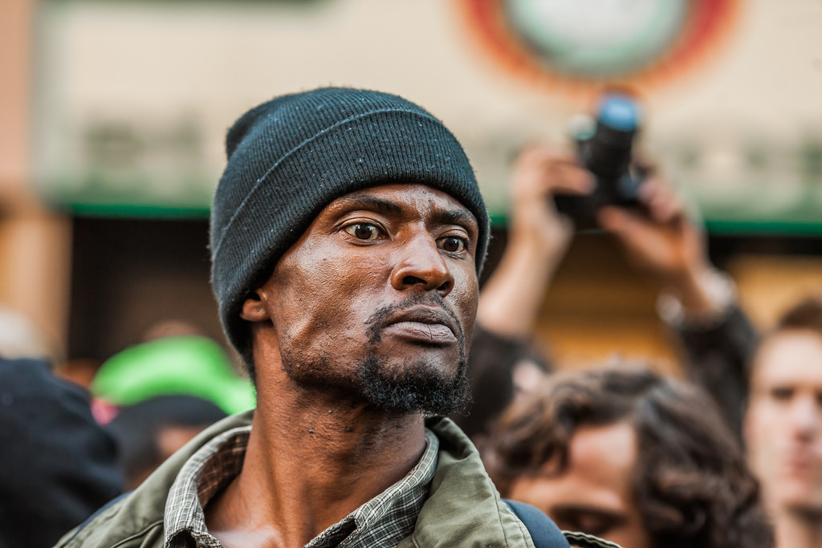

Slide 9
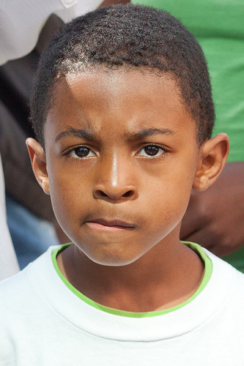
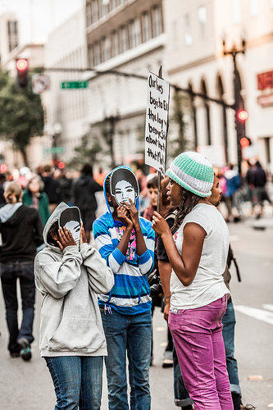

Slide 10
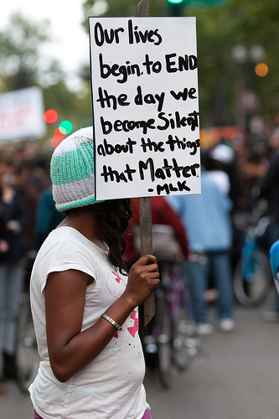
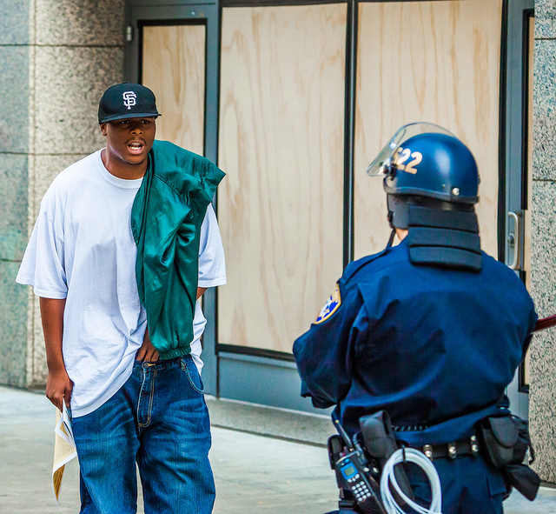

Slide 11
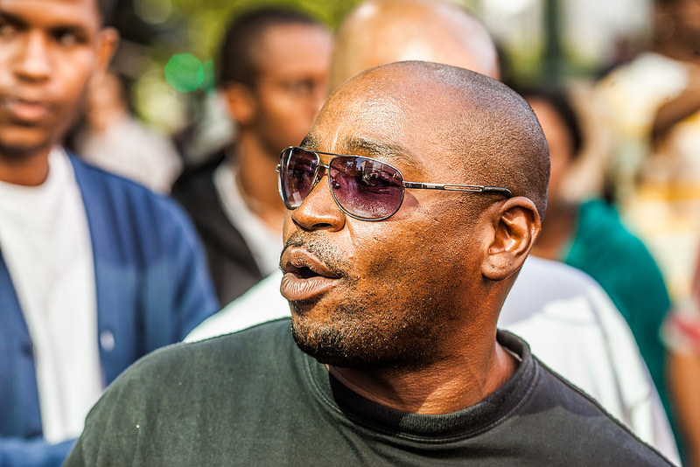

Slide 12
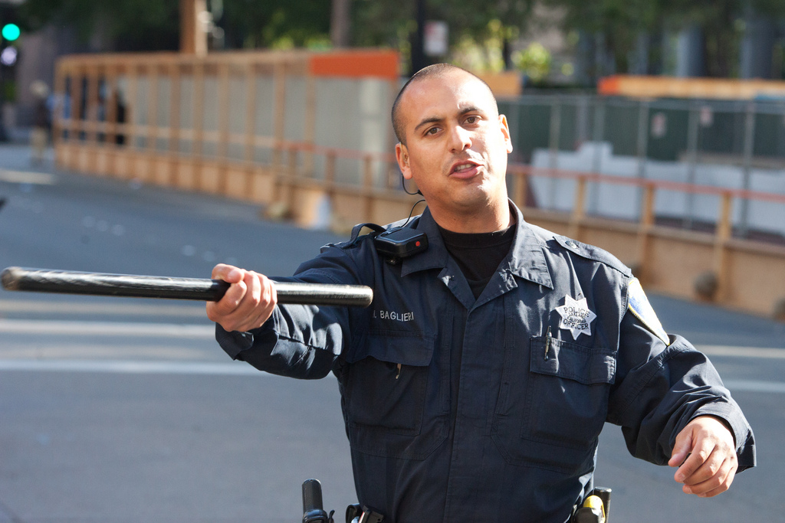

Slide 13
As the crowd grew, protesters decided to take over the intersection of 14th and Broadway. One protester blocked a bus in the intersection which was quickly surrounded by other protesters. This is when the police showed up. At first a small group of officers made their way towards the bus in a small police ATV with a loudspeaker/crowd control device on the top. They demanded that protesters let the bus go though. They had since blocked off Broadway to other traffic. Tension was very high and protesters immediately began to crowd towards the ATV and it had to rapidly reverse course so as not to get surrounded. A police car also made its way to rescue the bus but it too was almost engulfed in people. The police car quickly went into reverse and a woman was knocked down. Protesters claimed that the police ran over and injured the woman.

Slide 14
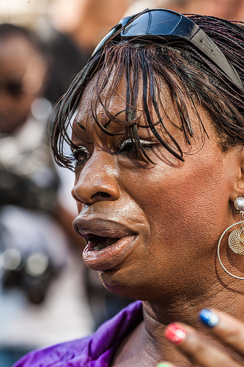

Slide 15
Police then held a riot line in full riot gear on 13th Street just West of Broadway. Here protesters began taunting the riot police. Protesters were demanding that the police take a police report for running over the woman. They demanded that they help the woman but the police wouldn't break their line and told protesters that emergency professionals were on the way to assist the woman.

Slide 16
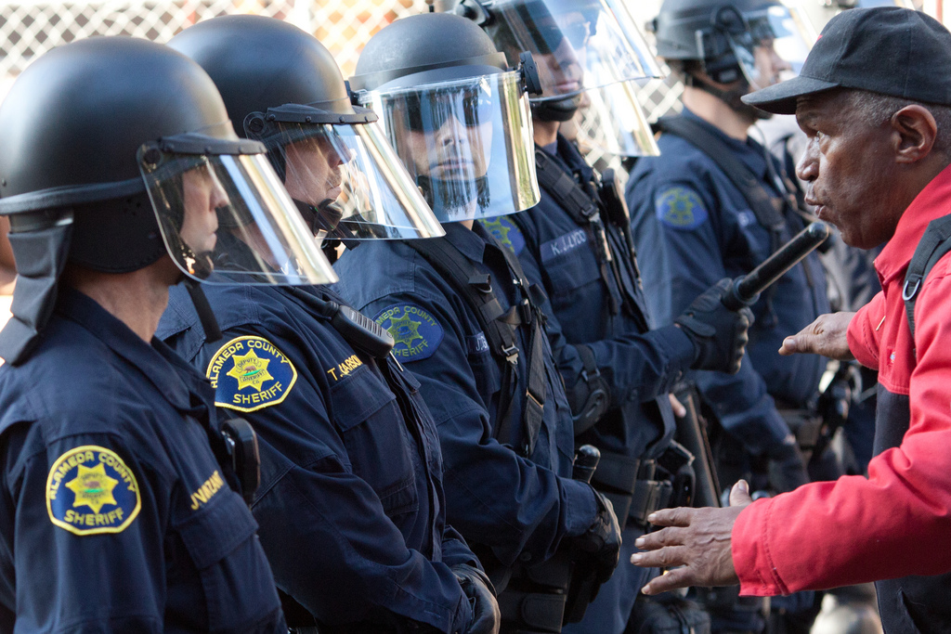
Police then held a riot line in full riot gear on 13th Street just West of Broadway. Here protesters began taunting the riot police (see photo at top). Protesters were

Slide 17
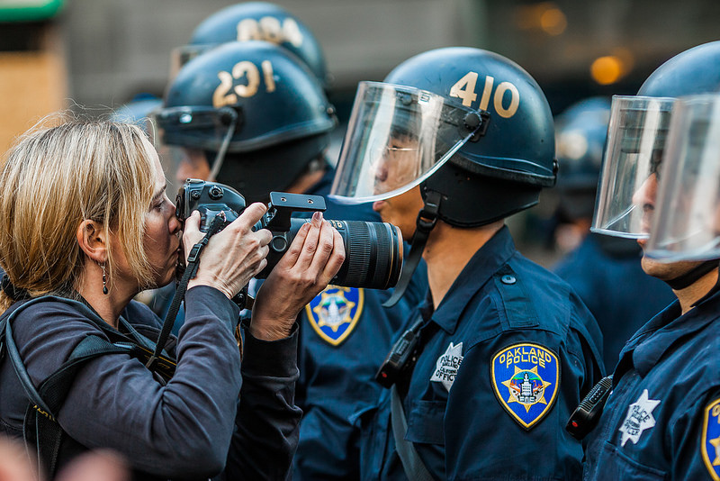

Slide 18
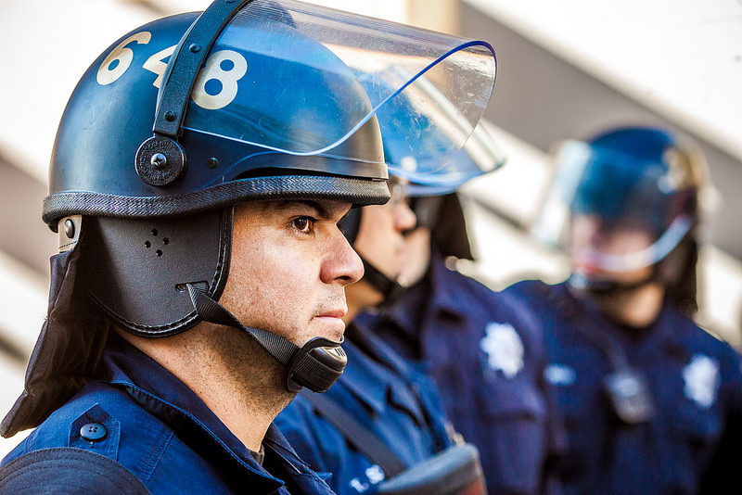

Slide 19
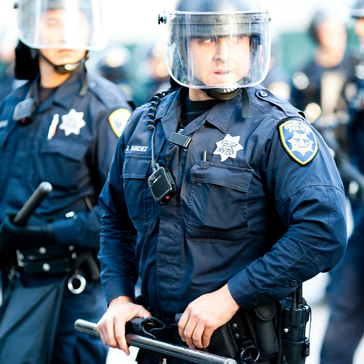
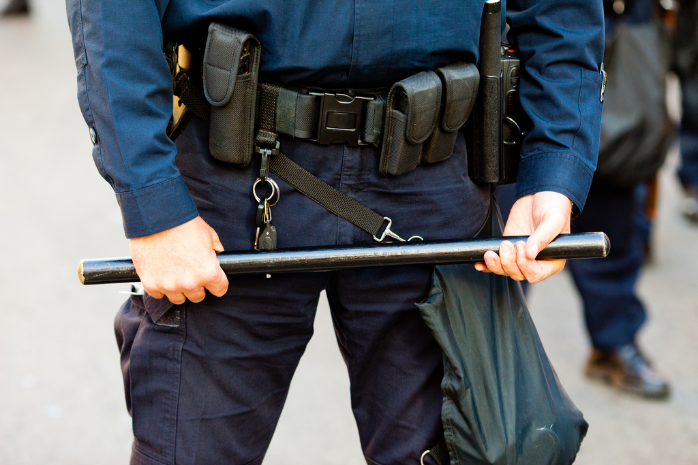

Slide 20
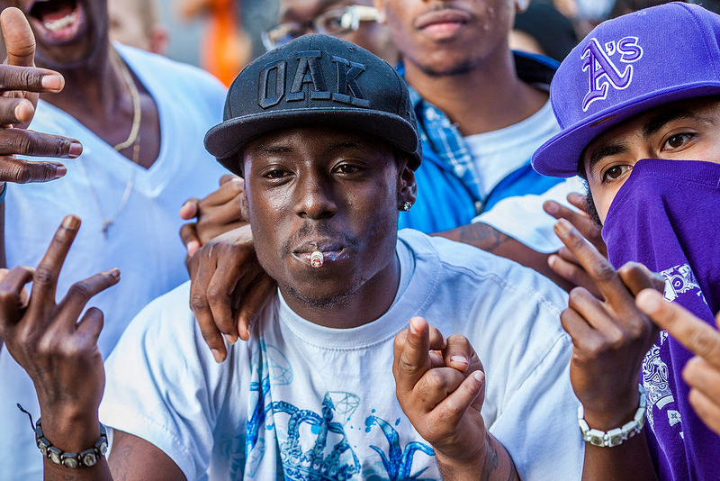

Slide 21
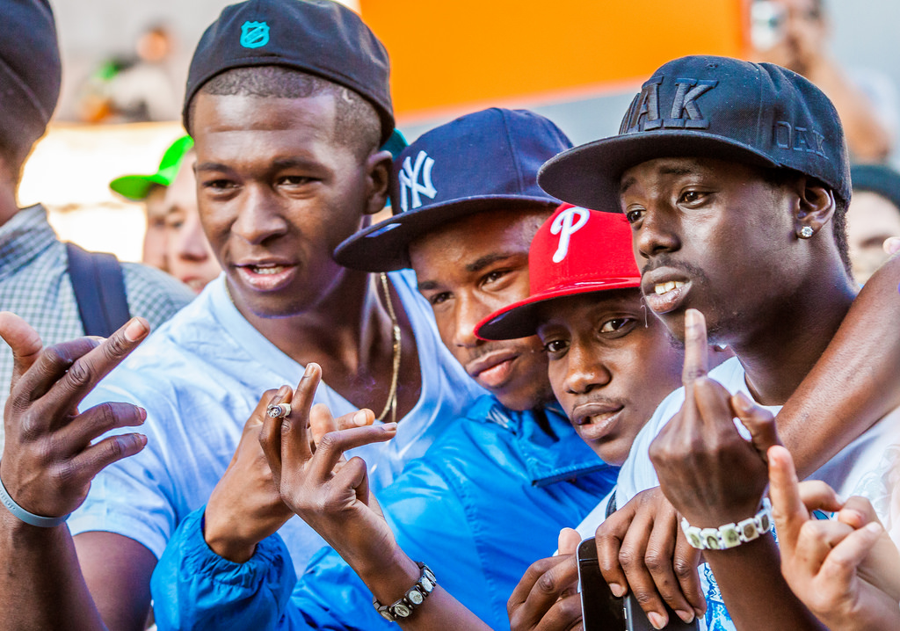

Slide 22
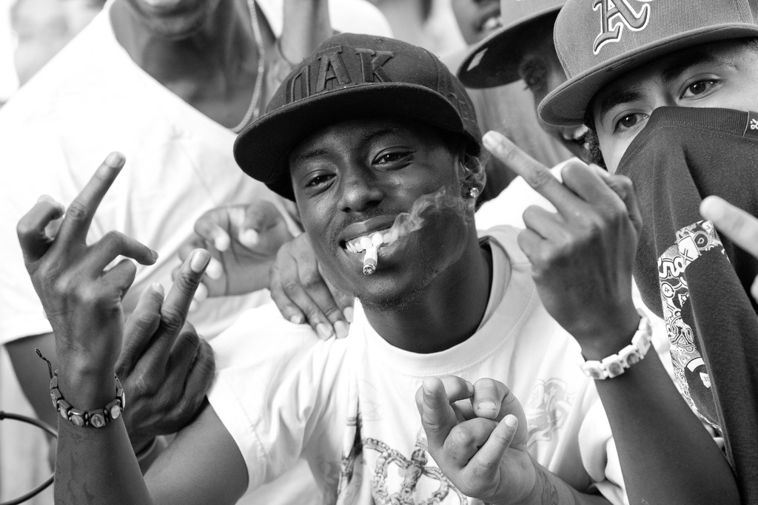

Slide 23
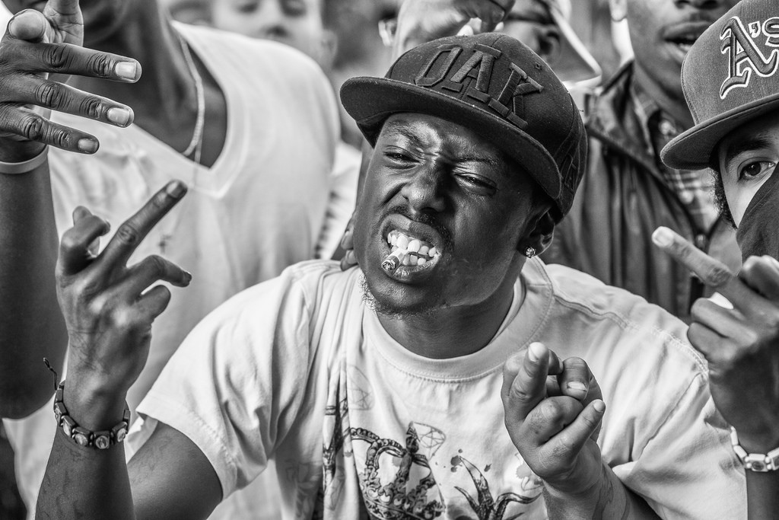

Slide 24
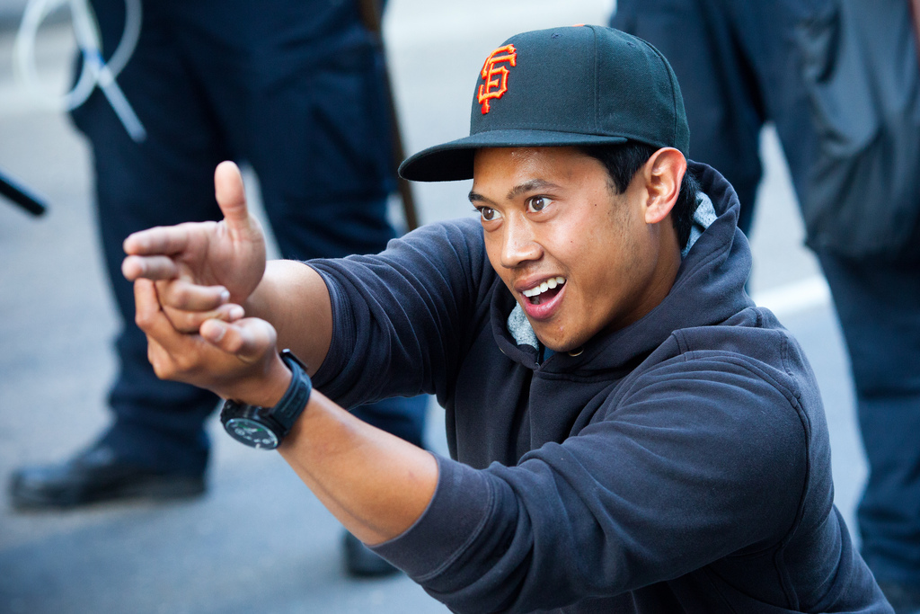

Slide 25
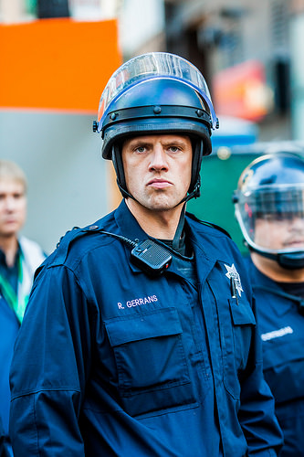

Slide 26
Oakland PD had been training for these riots and quickly surrounded Broadway street with riot police lines effectively containing everybody in an area between 13th and 15th on Broadway. For the next few hours things seemed to really calm down after this. The police held their riot lines but allowed people in and out of the protest area. Several speakers including Oscar Grant's grandfather gave speeches on a loudspeaker at the corner of Broadway and 14th calling for peace and trying to keep the crowd from turning violent.

Slide 27
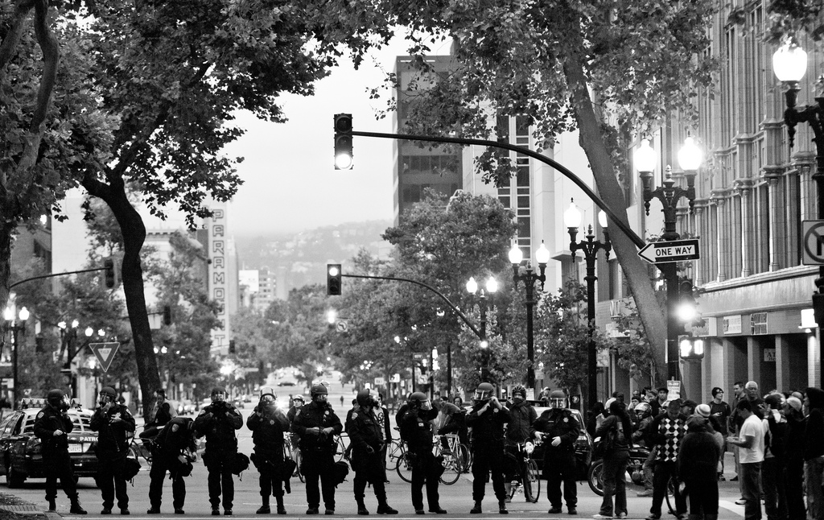

Slide 28
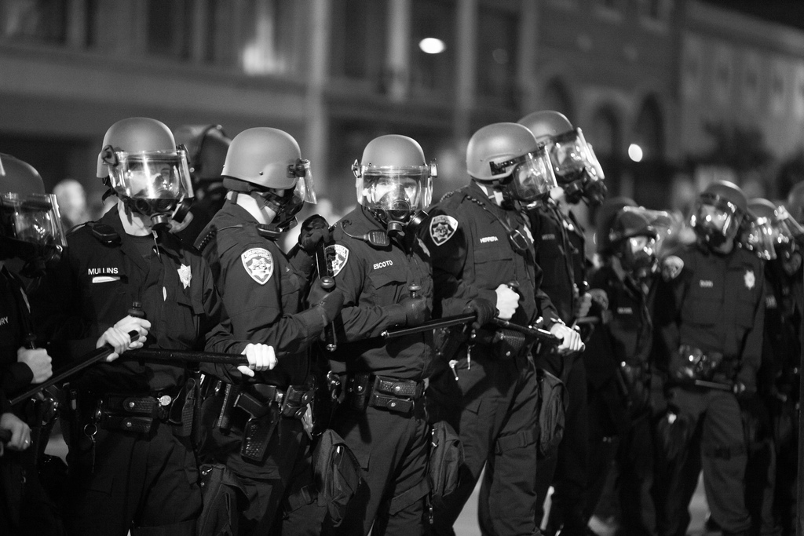

Slide 29
The first business to be vandalized that I saw was a Subway Sandwich shop. Protesters broke the windows of the store. It was about this time that the Oakland PD decided to begin containing the crowd and moved the riot line from 13th Street up Broadway. This is when things started to get ugly. There were some heated interactions with protesters that quickly turned violent as police began yanking a few protesters in their way out of the way and arresting them. They forced their way about halfway up Broadway between 13th and 14th Streets and commanded on their loudspeakers that people move North on Broadway.

Slide 30
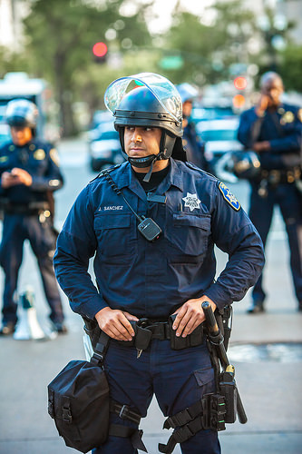
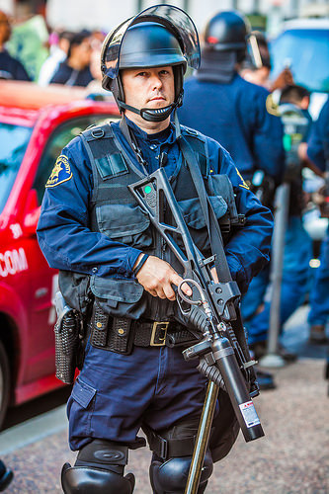

Slide 31
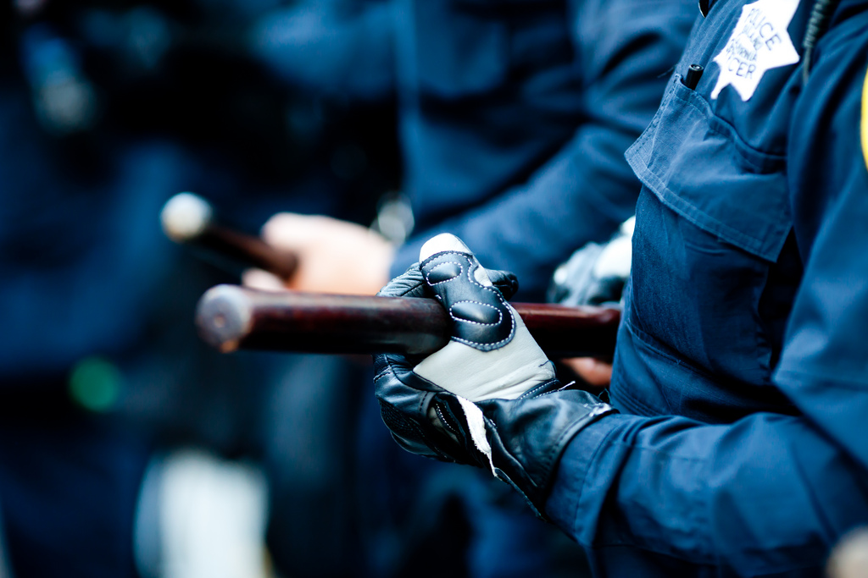

Slide 32
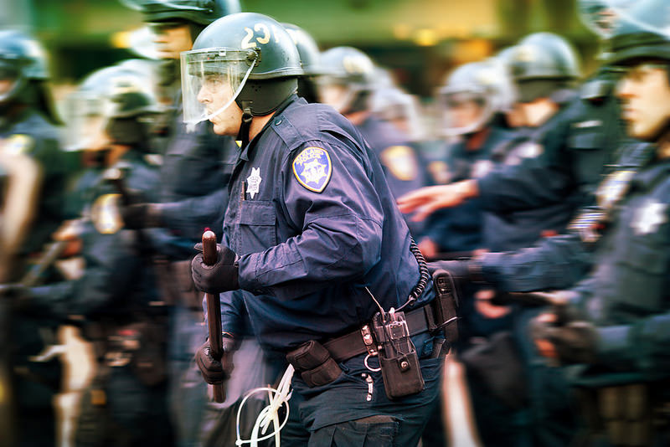

Slide 33
People started then throwing rocks and bottles at the riot police. The riot police largely ignored this activity and held their lines. The California Highway Patrol rolled in as reinforcement and handled a big part of the Northern riot line. Protesters were angry and upset with some of the CHP officers who had brought assault style weaponry with them.
Protesters then turned violent on the businesses mostly between 14th and 15th Streets on Broadway. Most of the businesses on this stretch of Broadway had their windows broken out. Some of the businesses had been boarded up and so looters could not get in. But looters did manage to get into the Foot Locker and began stealing all of the merchandise in the store. At this point the police all of a sudden made some very rapid pushes up Broadway which startled the crowd and sent everyone running the other way up Broadway. Several protesters were violently yanked from the front of the line and pulled back and arrested.

Slide 34
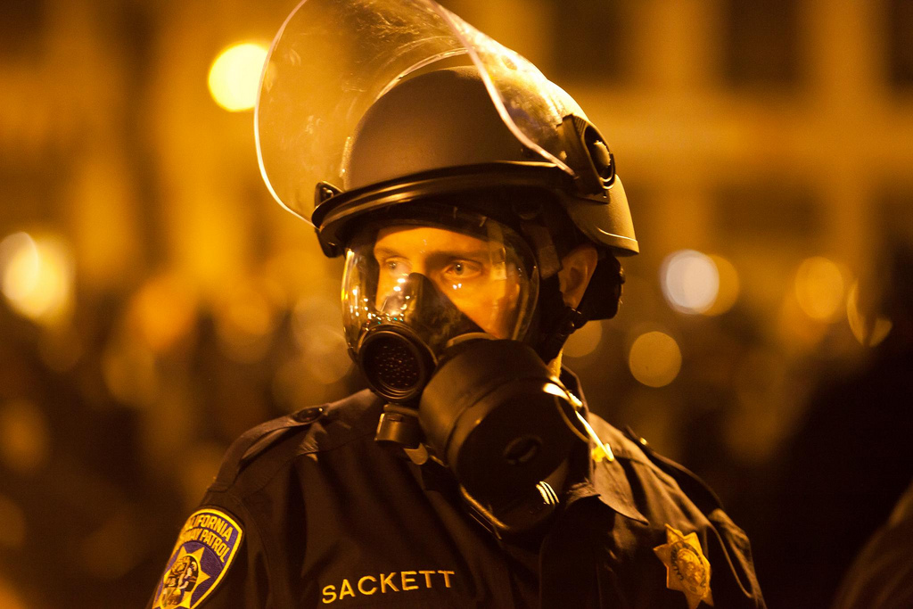
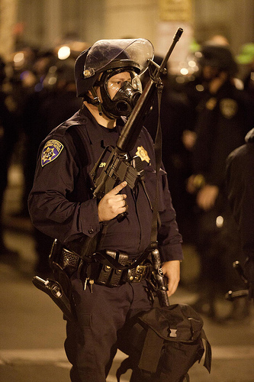

Slide 35
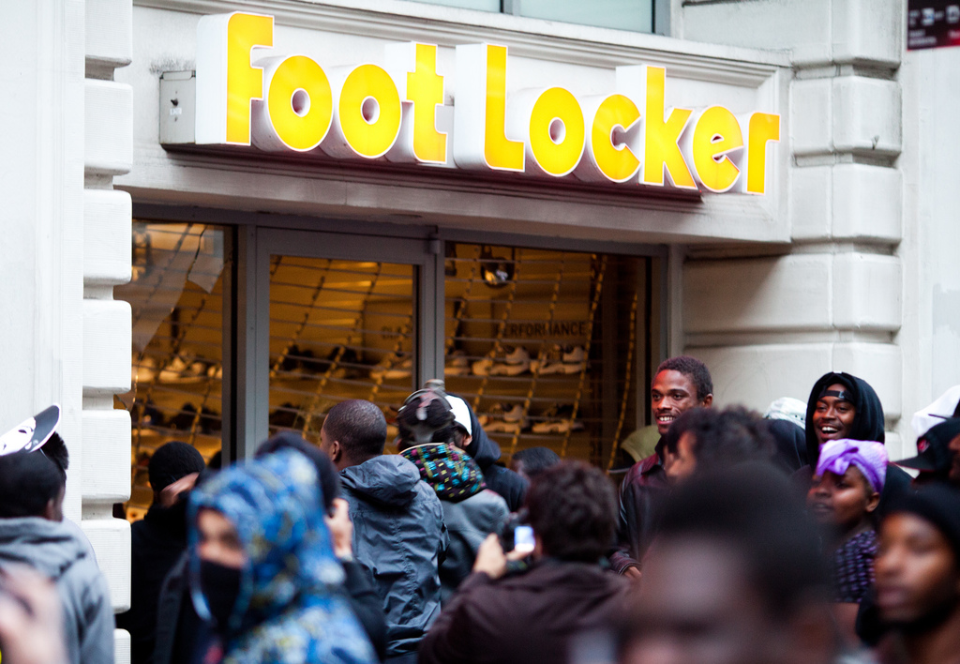

Slide 36
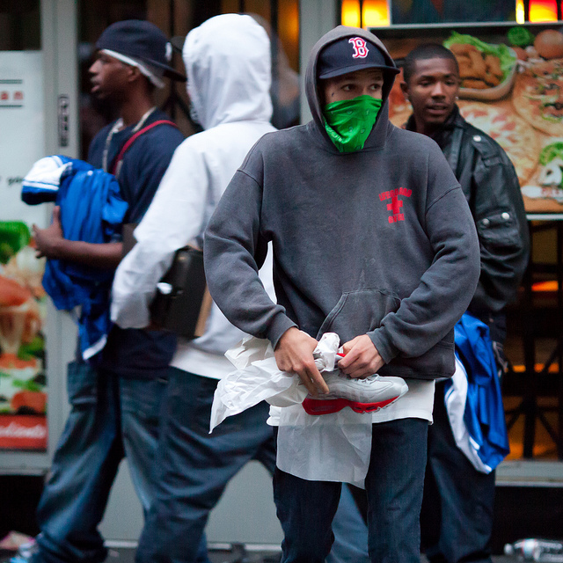

Slide 37
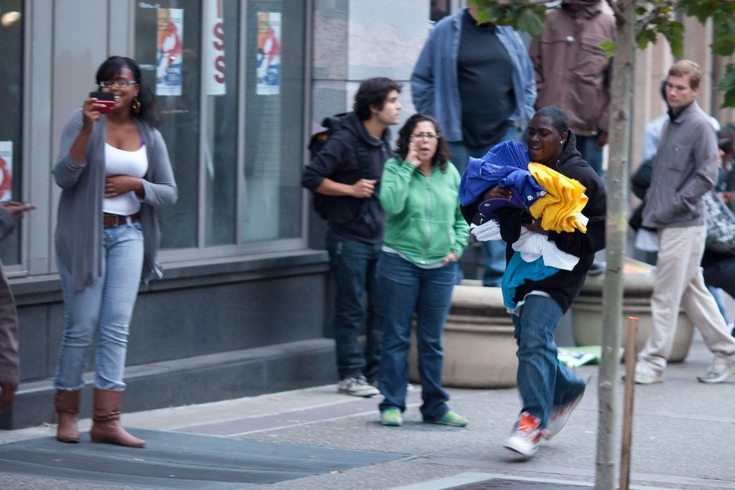

Slide 38
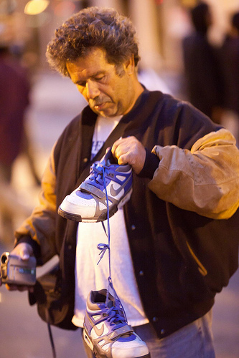

Slide 39
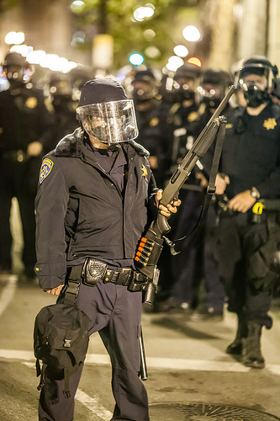

Slide 40
It had grown dark by this time and rioters were also setting many small fires around the area in the trashcans and with debris from the Foot Locker store. It was at this point, at about 9pm, that police began to squeeze all of the protesters into a smaller and smaller space. At it's height there were probably about 3,000 or so protesters in the area I'd estimate. By dark though there were probably only about 400 or so left. It was then that police came on their loudspeakers informing the crowd that they were an unlawful assembly and told everyone that anyone in the area would be subject to immediate arrest.

Slide 41
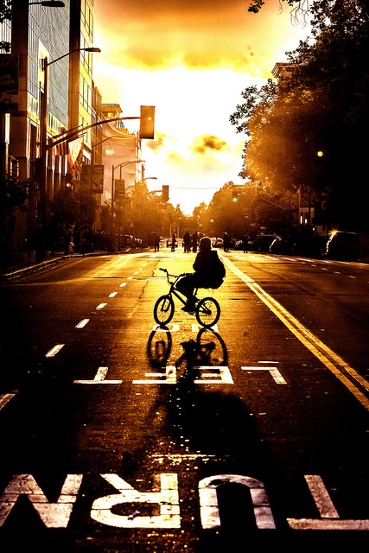

Slide 42
Protesters continued vandalizing the area mostly damaging storefronts and police cars which where parked on Broadway. At this point I decided to leave to avoid arrest and went down to the 19th Street BART station. Shortly after I entered the BART station they closed the station which was heavily patrolled by BART police in RIOT gear. At that point they directed people to the 12th Street BART station which had heavily patrolled and controlled entrances.
From news reports that I watched after that they said that smaller bands of rioters continued to riot in areas around 17th Street, but that the majority of the crowd had been dispersed. Oakland Mayor Ron Dellums along with Oakland Police Chief Anthony Batts monitored the situation from a command center and the police continued to arrest protesters that they could on the streets

Slide 43
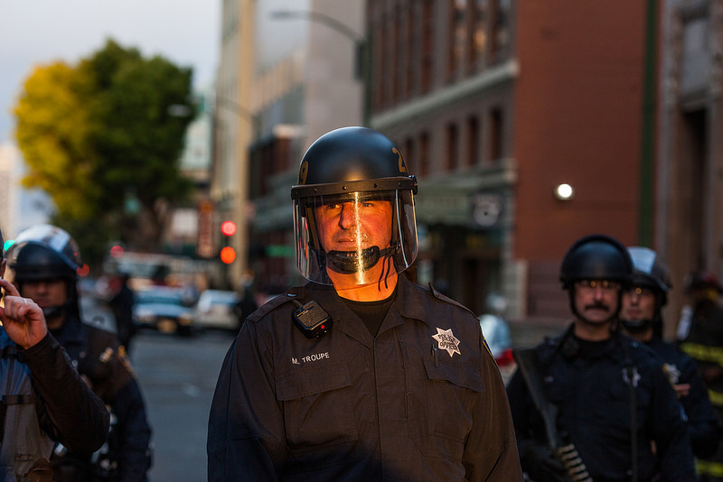

Slide 44
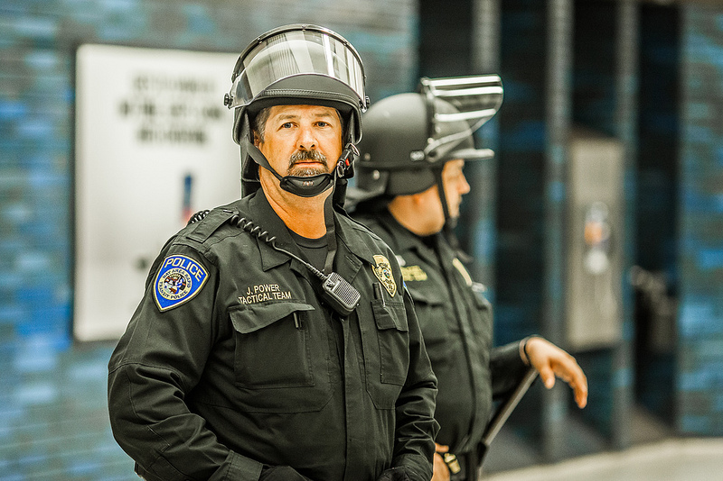

Slide 45
Overall I have to give credit to the Oakland PD for the way that they handled this very dangerous situation. I was impressed with their professionalism and how well they managed to prevent the crowd from turning into a much bigger riot than it was. It was a very tough night to be a cop in Oakland and you could tell from their own facial expressions that they were under a tremendous amount of stress maintaining the peace….

Slide 46
